Slide 1
ECE 884 Deep Learning
Lecture 19: RNN Applications and Attention
03/30/2021

Slide 2
Review of last lecture
Recurrent Neural Network (RNN)
Word Embeddings
Simple / Vanilla RNN
Long Short Term Memory (LSTM)
Making RNNs More Effective

Slide 3
Today’s lecture
RNN Applications
Text generation (many to one)
Image Captioning (one to many)
Neural Machine Translation (many to many - Seq2Seq)
Attention with RNN
Self-attention with RNN
Notes:
To add:
Weight initialization
Batch normalization

Slide 4
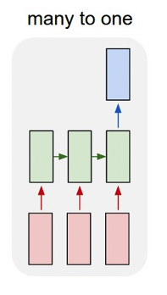
Text Generation

Slide 5
RNN for Text Prediction
Example
Input text: “the cat sat on the ma”
Question: what is the next char?

Slide 6
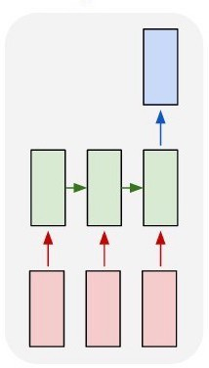
RNN for Text Prediction
Example
Input text: “the cat sat on the ma”
Question: what is the next char?
Softmax(𝐖𝐡 )
State: 𝐡
sequence (char-level)
input text

Slide 7
RNN for Text Prediction
Example
predict the next char
Input text: “the cat sat on the ma”
Question: what is the next char?
Softmax(𝐖𝐡. )
RNN outputs a distribution over the chars.
State: 𝐡
sequence (char-level)
input text

Slide 8
RNN for Text Prediction
Example
predict the next char
Input text: “the cat sat on the ma”
Question: what is the next char?
RNN outputs a distribution over the chars.
Sample a char from it; we may get ‘t’.
Take “the cat sat on the mat” as input.
Maybe the next char is period ‘.’.
sequence (char-level)
input text

Slide 9
Train an RNN for Text Prediction
How do we train such an RNN?
predict the next char
Cut text to segments (with overlap).
E.g., seg_len=40 and stride=3.
Machine learning is a subset of artificial intelligence in the field of computer science that often uses statistical techniques to give computers the ability to "learn" (i.e., progressively improve performance on a specific task) with data, without being explicitly programmed. The name machine learning was coined in 1959 by Arthur Samuel.
…
…
sequence (char-level)
input text

Slide 10
Train an RNN for Text Prediction
How do we train such an RNN?
predict the next char
Cut text to segments (with overlap).
E.g., seg_len=40 and stride=3.
Machine learning is a subset of artificial intelligence in the field of computer science that often uses statistical techniques to give computers the ability to "learn" (i.e., progressively improve performance on a specific task) with data, without being explicitly programmed. The name machine learning was coined in 1959 by Arthur Samuel.
…
…
sequence (char-level)
input text

Slide 11
Train an RNN for Text Prediction
How do we train such an RNN?
predict the next char
Cut text to segments (with overlap).
E.g., seg_len=40 and stride=3.
Machine learning is a subset of artificial intelligence in the field of computer science that often uses statistical techniques to give computers the ability to "learn" (i.e., progressively improve performance on a specific task) with data, without being explicitly programmed. The name machine learning was coined in 1959 by Arthur Samuel.
…
…
sequence (char-level)
input text

Slide 12
Train an RNN for Text Prediction
How do we train such an RNN?
predict the next char
Cut text to segments (with overlap).
E.g., seg_len=40 and stride=3.
Machine learning is a subset of artificial intelligence in the field of computer science that often uses statistical techniques to give computers the ability to "learn" (i.e., progressively improve performance on a specific task) with data, without being explicitly programmed. The name machine learning was coined in 1959 by Arthur Samuel.
…
…
sequence (char-level)
input text

Slide 13
Train an RNN for Text Prediction
How do we train such an RNN?
predict the next char
Cut text to segments (with overlap).
A segment is used as input text.
Its next char is used as label.
Training data: (segment, next_char) pairs
Machine learning is a subset of artificial intelligence in the field of computer science that often uses statistical techniques to give computers the ability to "learn" (i.e., progressively improve performance on a specific task) with data, without being explicitly programmed. The name machine learning was coined in 1959 by Arthur Samuel.
…
…
sequence (char-level)
input text

Slide 14
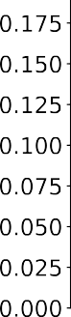
Train an RNN for Text Prediction
How do we train such an RNN?
predict the next char
• Cut text to segments (with overlap).
• A segment is used as input text.
• Its next char is used as label.
• Training data: (segment, next_char) pairs
It is a multi-class classification problem.
#class = #unique chars.
sequence (char-level) input text

Slide 15
Train an RNN for Text Prediction
How do we train such an RNN?
predict the next char
• Cut text to segments (with overlap).
• A segment is used as input text.
• Its next char is used as label.
• Training data: (segment, next_char) pairs
It is a multi-class classification problem.
#class = #unique chars.
If the RNN is trained on Shakespeare’s books, then the generated text is Shakespeare’s style.
sequence (char-level)
input text

Slide 16
Text Generation#1
Generate baby names (trained on 8000 baby names).
Rudi Levette Berice Lussa Hany Mareanne Chrestina Carissy Marylen Hammine Janye Marlise Jacacrie Hendred Romand Charienna Nenotto Ette Dorane Wallen Marly Darine Salina Elvyn Ersia Maralena Minoria Ellia Charmin Antley Nerille Chelon Walmor Evena Jeryly Stachon Charisa Allisa Anatha Cathanie Geetra Alexie Jerin Cassen Herbett Cossie Velen Daurenge Robester Shermond Terisa Licia Roselen Ferine Jayn Lusine Charyanne Sales Sanny Resa Wallon Martine Merus Jelen Candica Wallin Tel Rachene Tarine Ozila Ketia Shanne Arnande Karella Roselina Alessia Chasty Deland Berther Geamar Jackein Mellisand Sagdy Nenc Lessie Rasemy Guen Gavi Milea Anneda Margoris Janin Rodelin Zeanna Elyne Janah Ferzina Susta Pey Castina

Slide 17
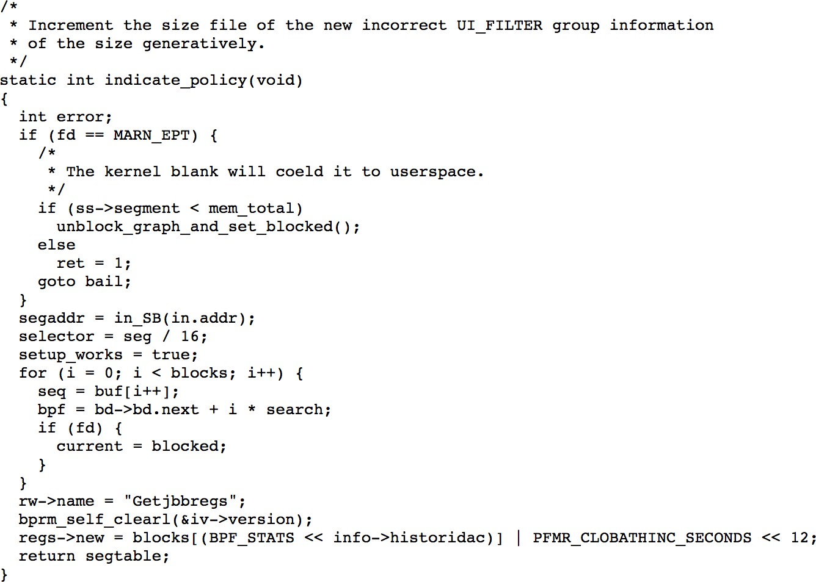
Text Generation#2
Generate C code (trained on Linux source code).

Slide 18
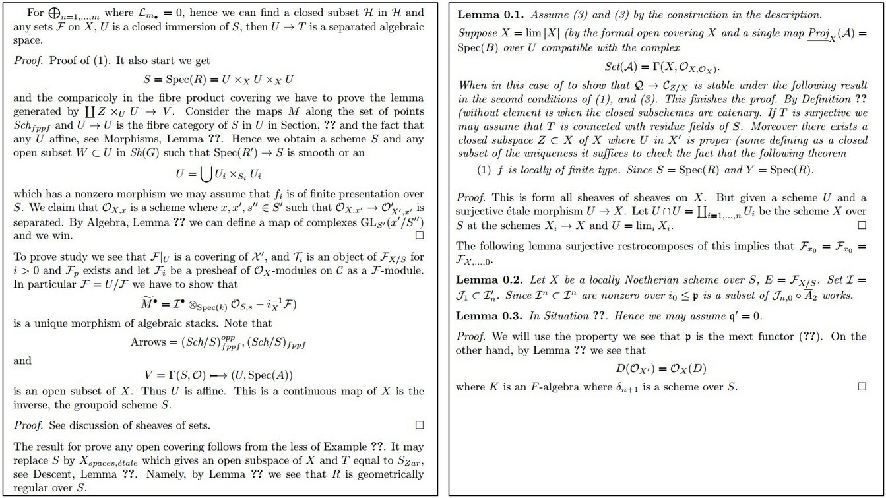
Text Generation#3
Generate academic articles (LaTeX source files).

Slide 19
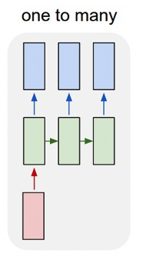
Image Captioning

Slide 20
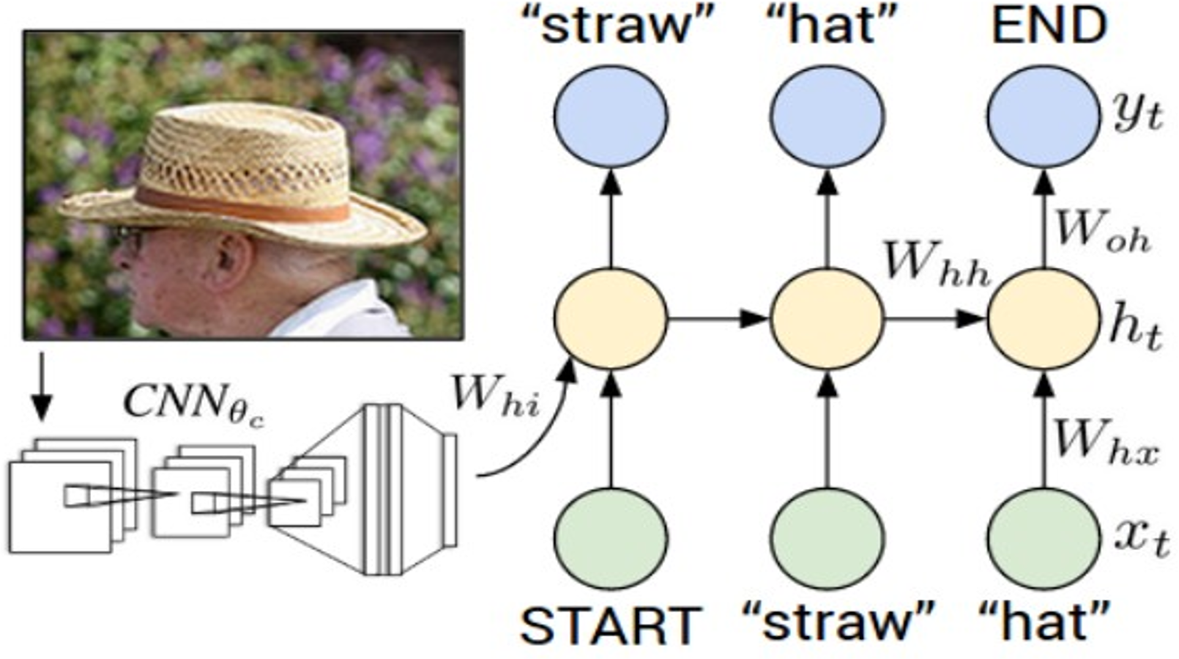
Image Captioning

Slide 21
Image Captioning
Recurrent Neural Network
Convolutional Neural Network

Slide 22
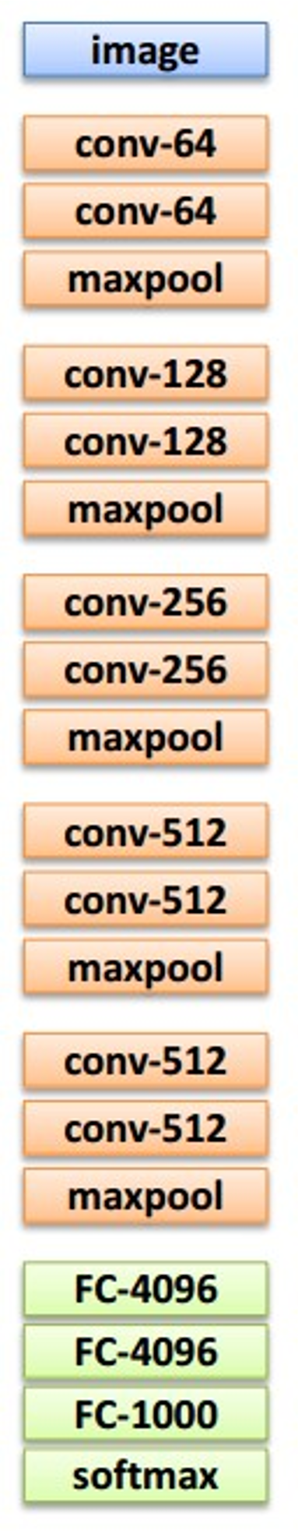

This image is CC0 public domain
Transfer learning: Take CNN trained on ImageNet, chop off last layer
X

Slide 23
This image is CC0 public domain
x0
<START>

Slide 24
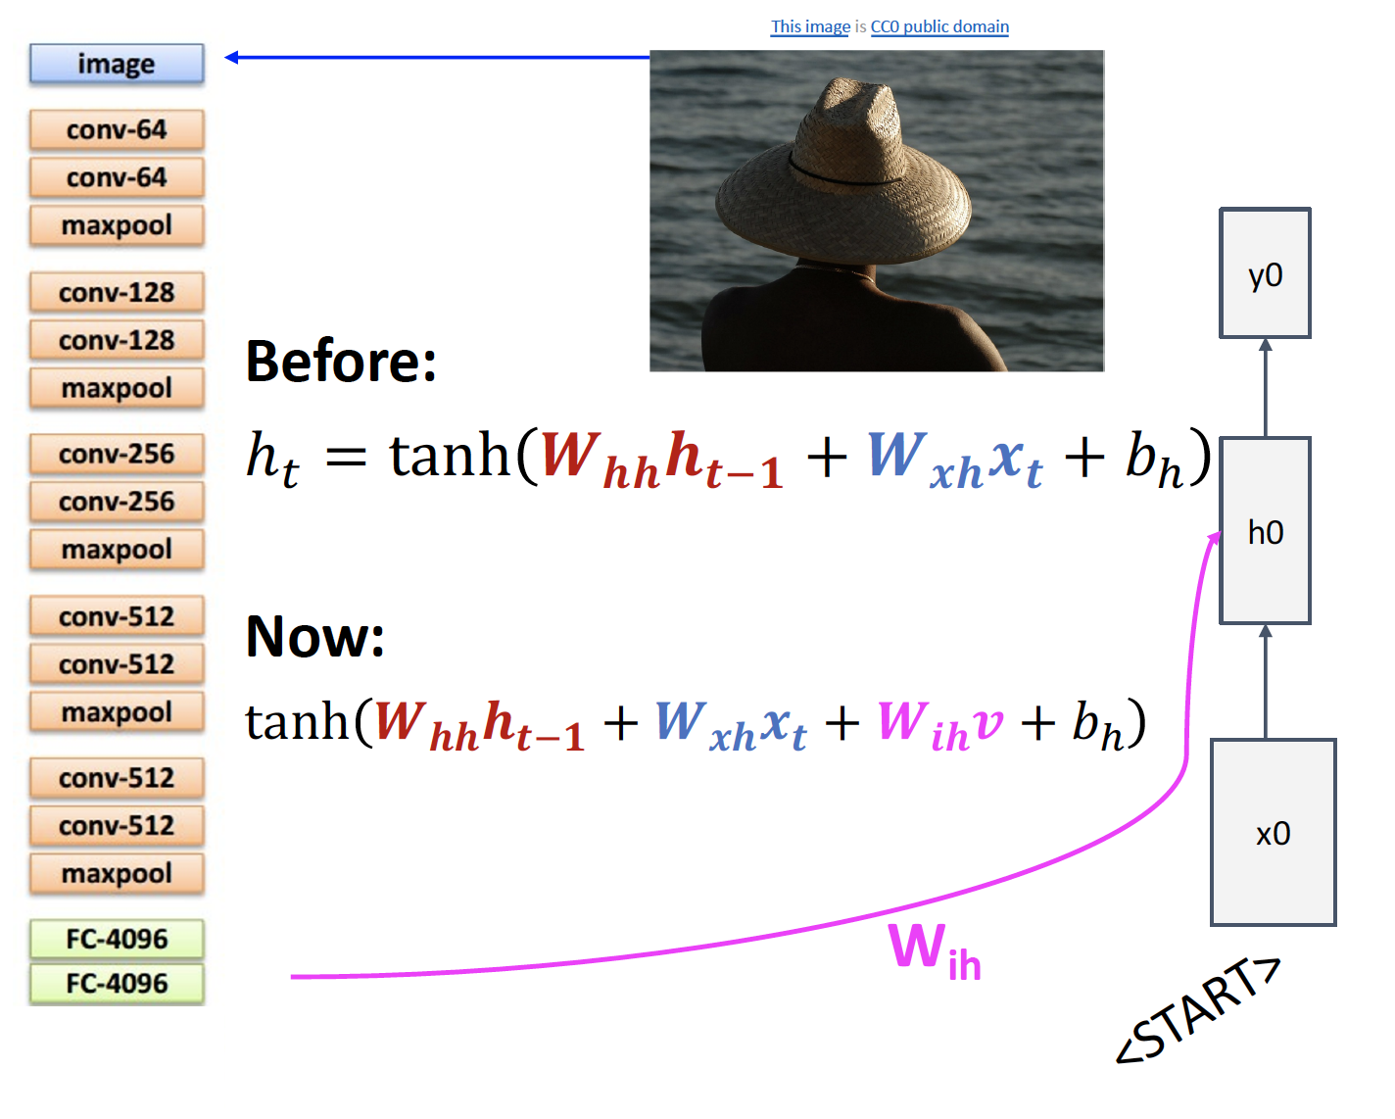

Slide 25
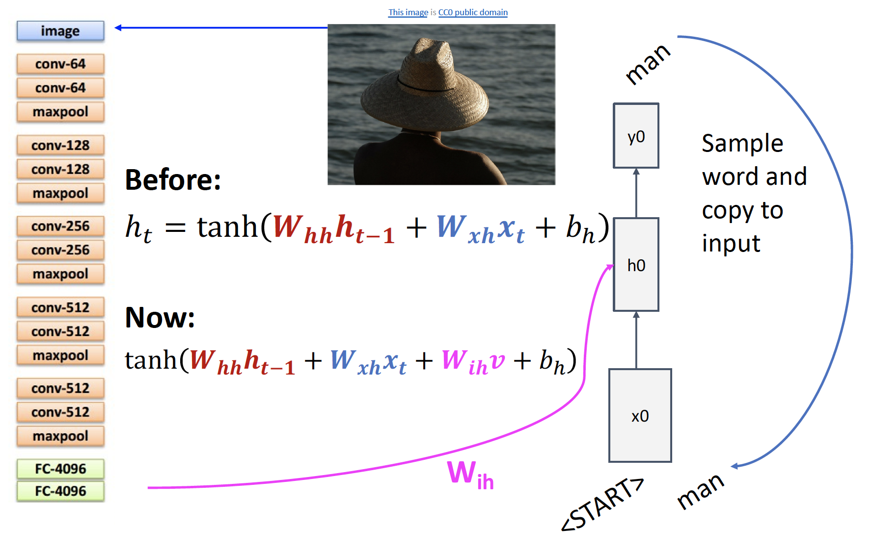

Slide 26
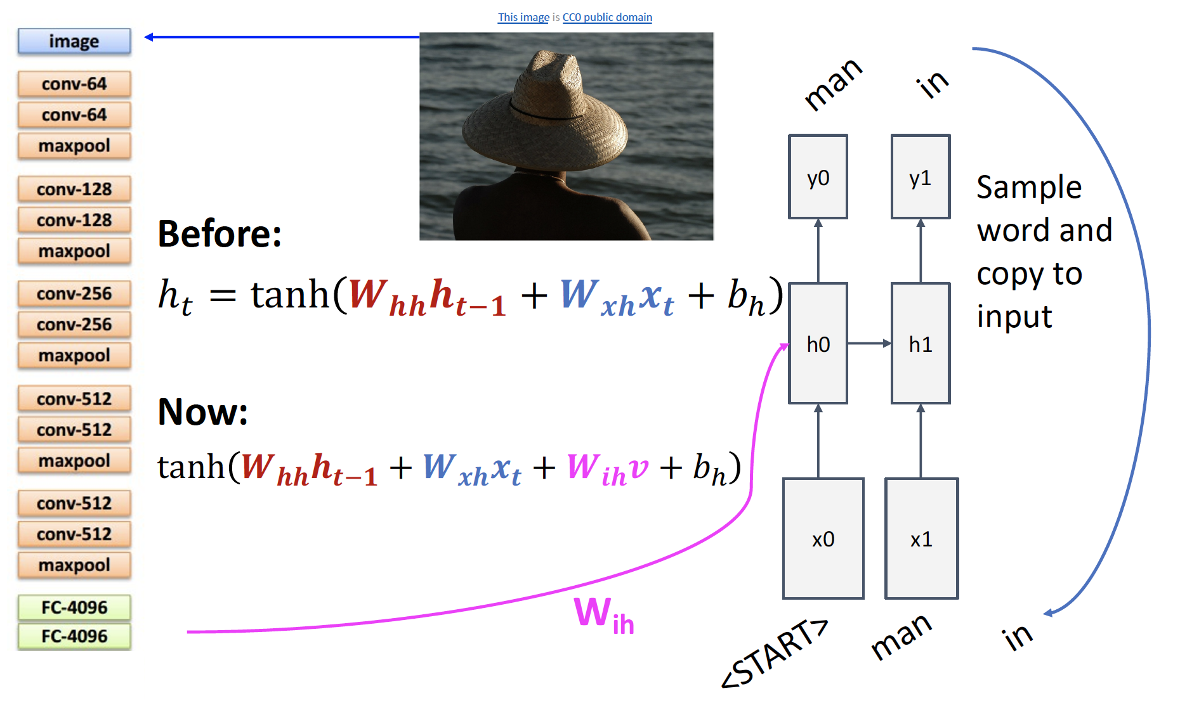

Slide 27
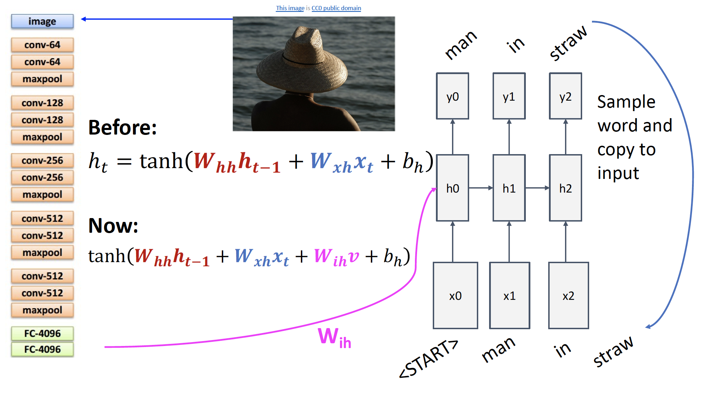

Slide 28
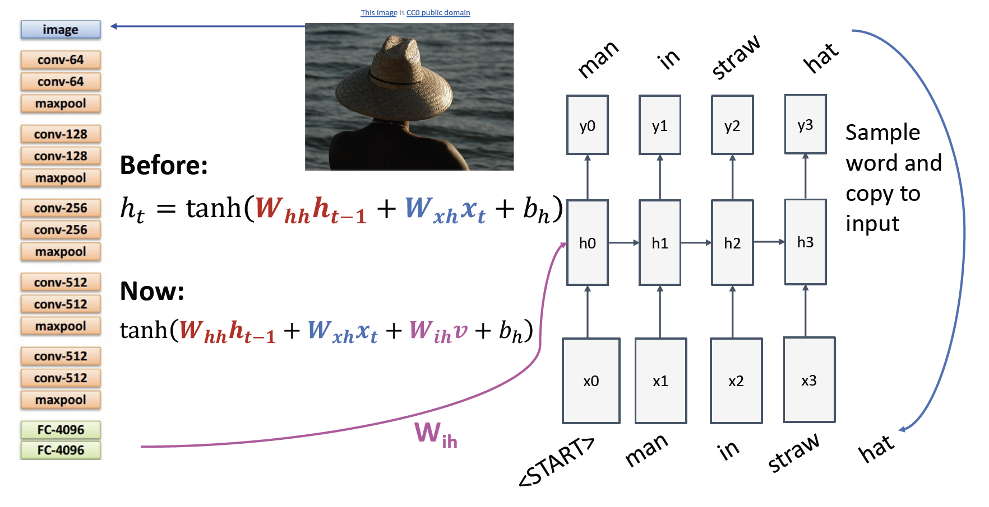

Slide 29
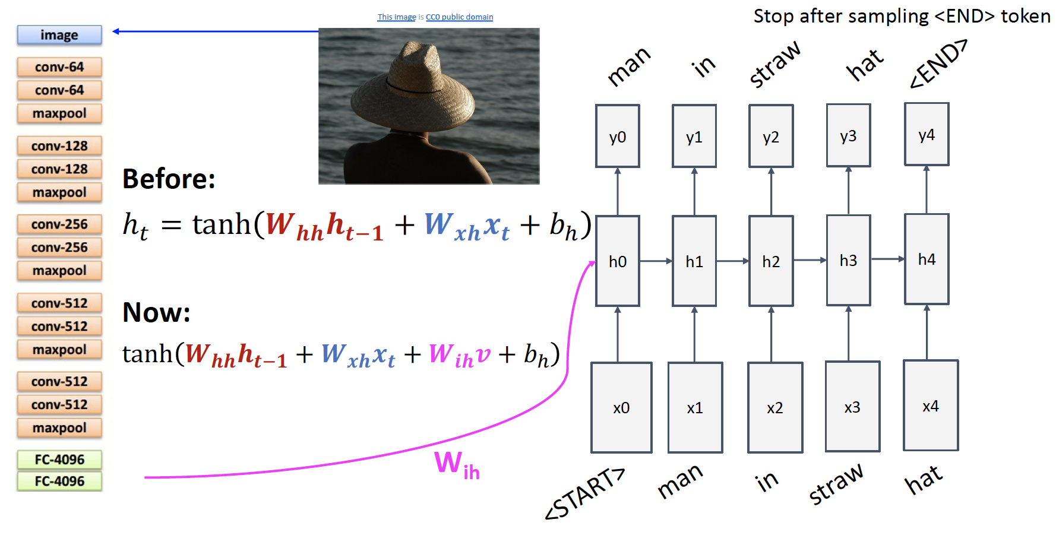

Slide 30

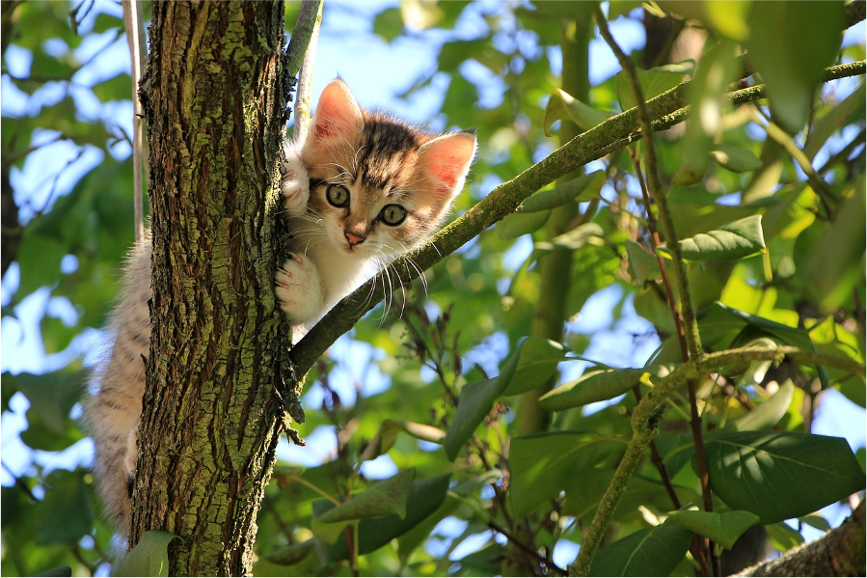
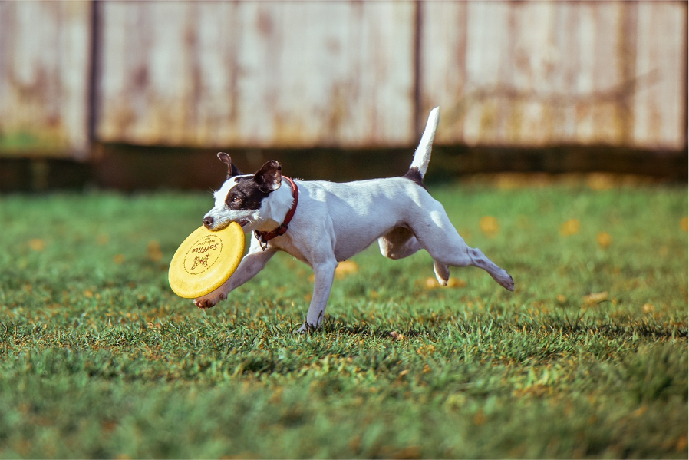


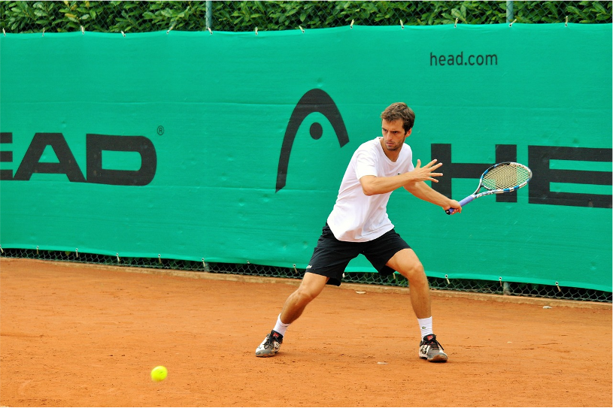
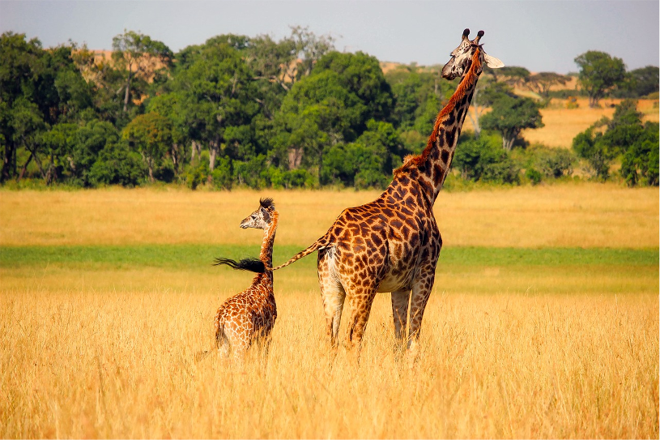
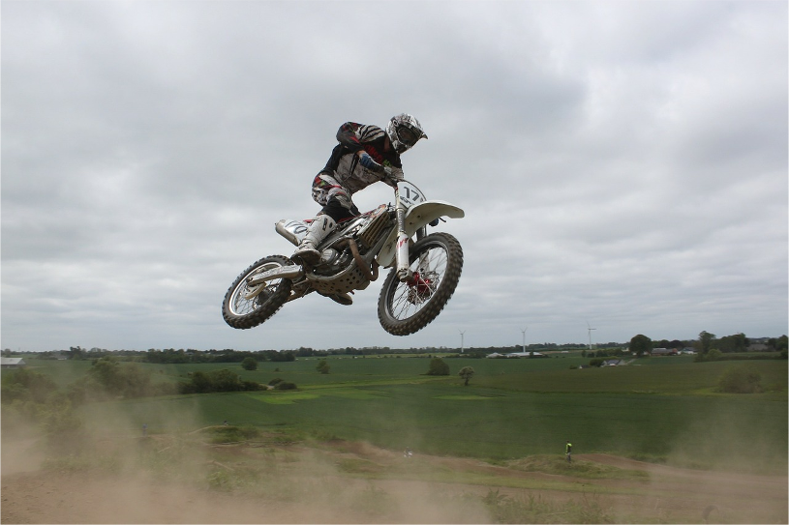
Image Captioning: Example Results
Captions generated using neuraltalk2 All images are CC0 Public domain: cat suitcase, cat tree, dog, bear, surfers, tennis, giraffe, motorcycle
A cat sitting on a suitcase on the floor
A cat is sitting on a tree branch
A dog is running in the grass with a frisbee
A white teddy bear sitting in the grass
Two people walking on the beach with surfboards
A tennis player in action on the court
Two giraffes standing in a grassy field
A man riding a dirt bike on a dirt track

Slide 31
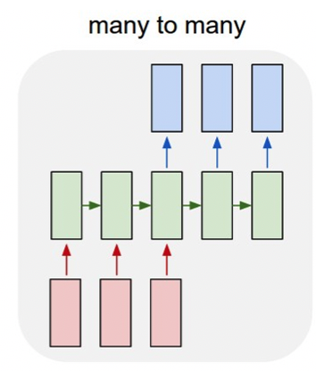
Neural Machine Translation

Slide 32
Neural Machine Translation
English
German
“do you agree” => [Seq2Seq] => “bist du einverstanden”
“go to sleep” => [Seq2Seq] => “gehen Sie schlafen”
“We will fight” => [Seq2Seq] => “Wir werden kämpfen”

Slide 33
Sequence-to-Sequence Model (Seq2Seq)

Slide 34
Seq2Seq Model
Seq2Seq adopts an encoder-decoder architecture
Encoder is an RNN
Decoder is an RNN

Slide 35
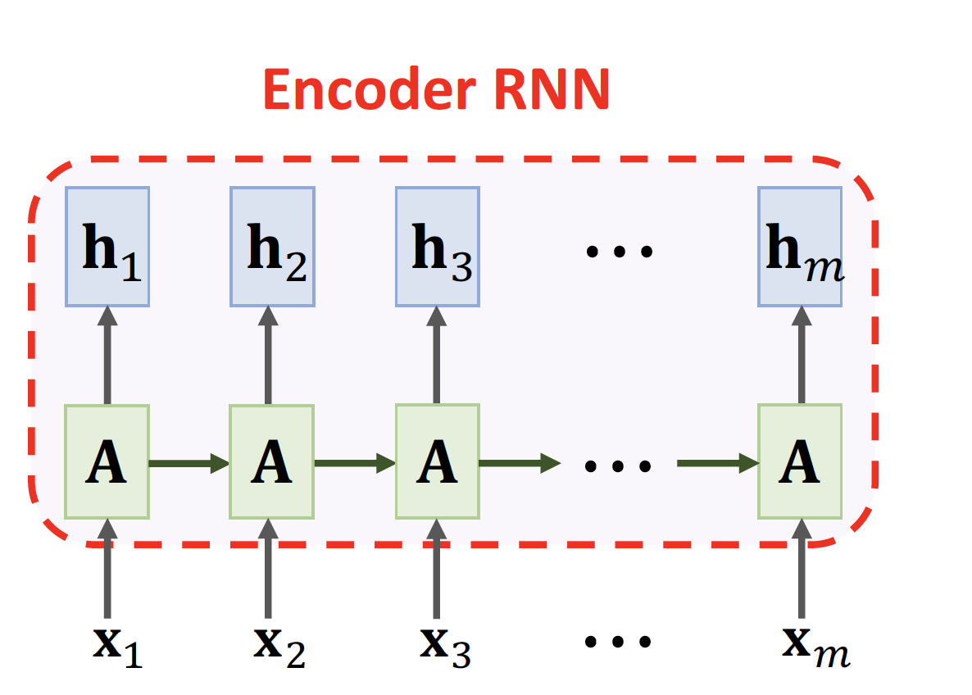
Seq2Seq Model

Slide 36
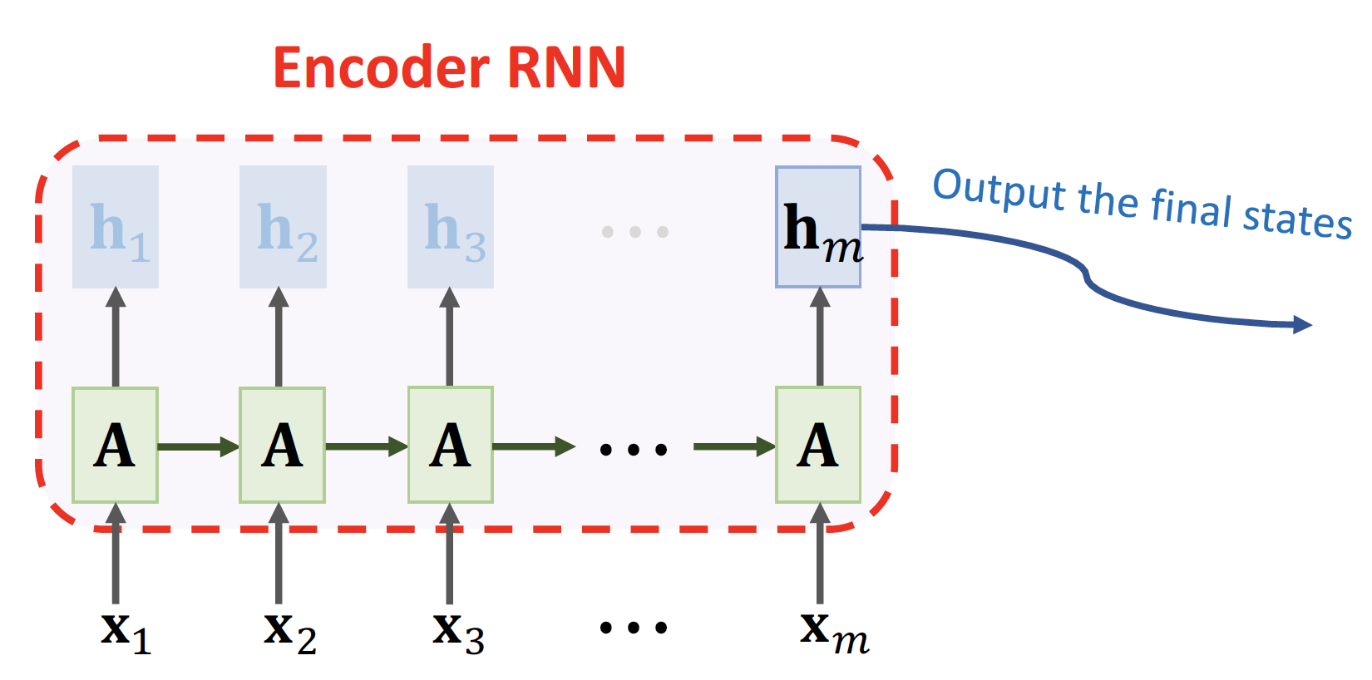
Seq2Seq Model

Slide 37
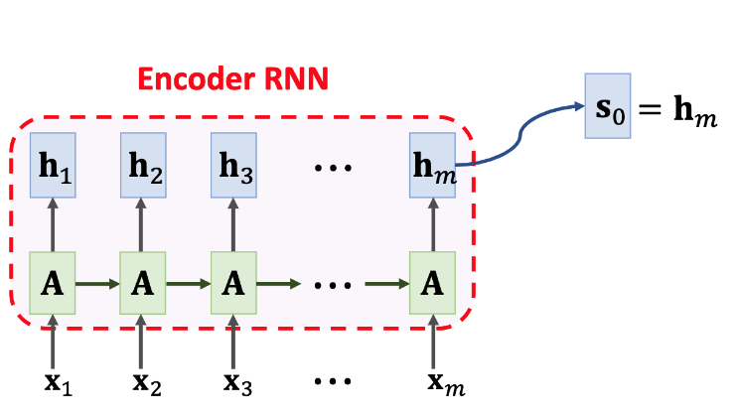
Seq2Seq Model

Slide 38
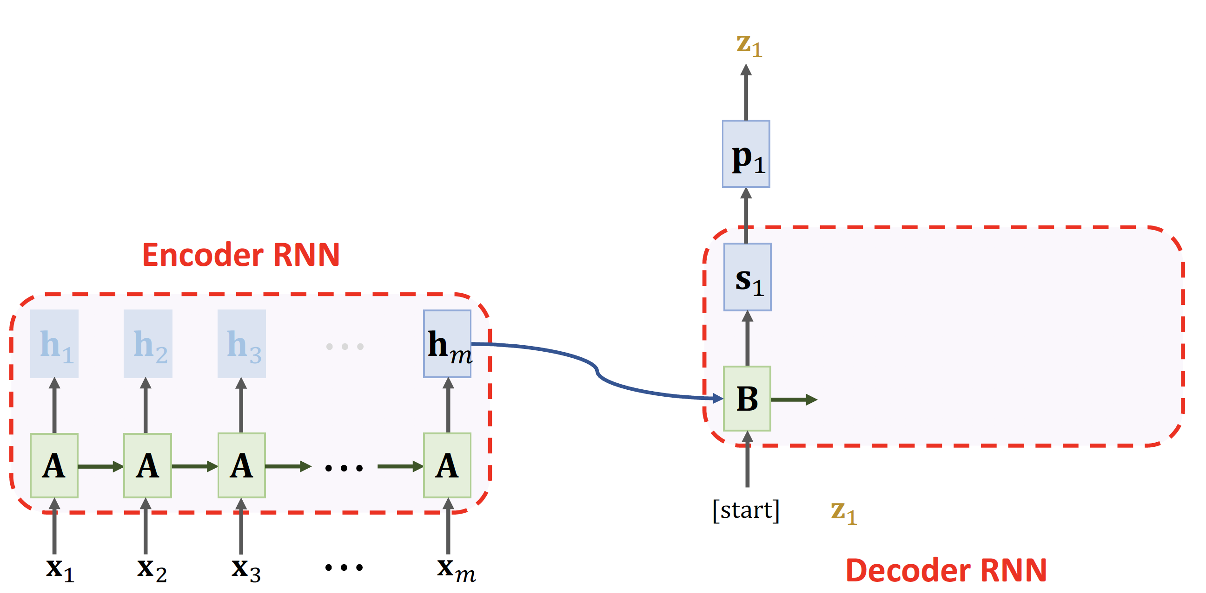
Seq2Seq Model

Slide 39
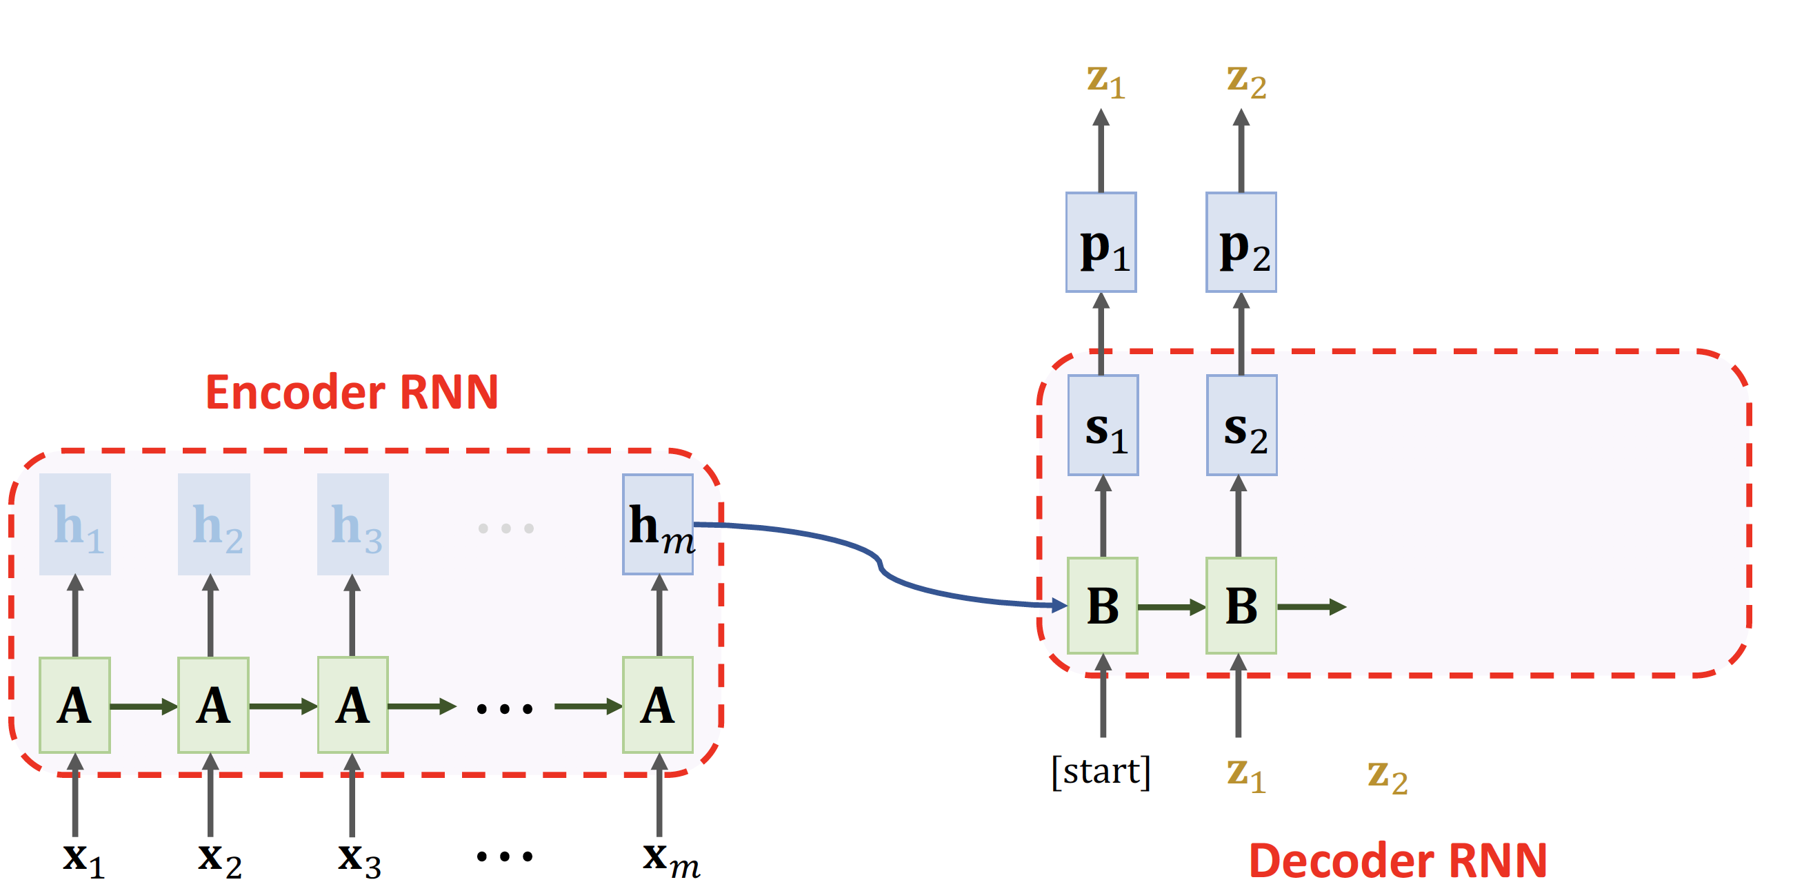
Seq2Seq Model

Slide 40
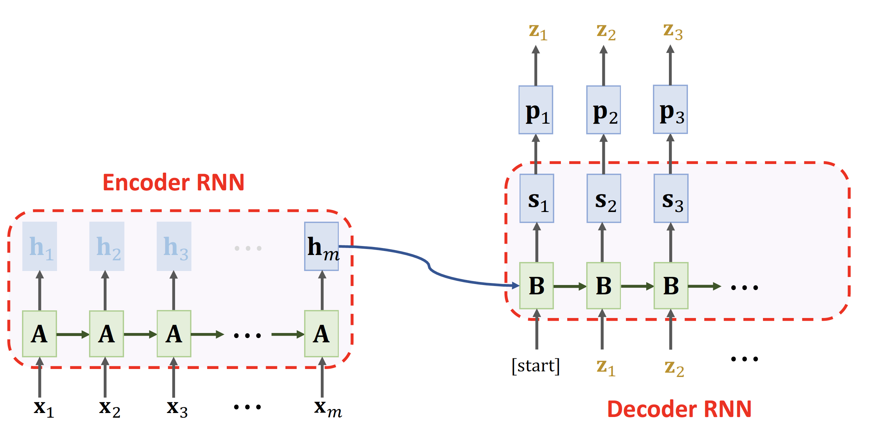
Seq2Seq Model

Slide 41
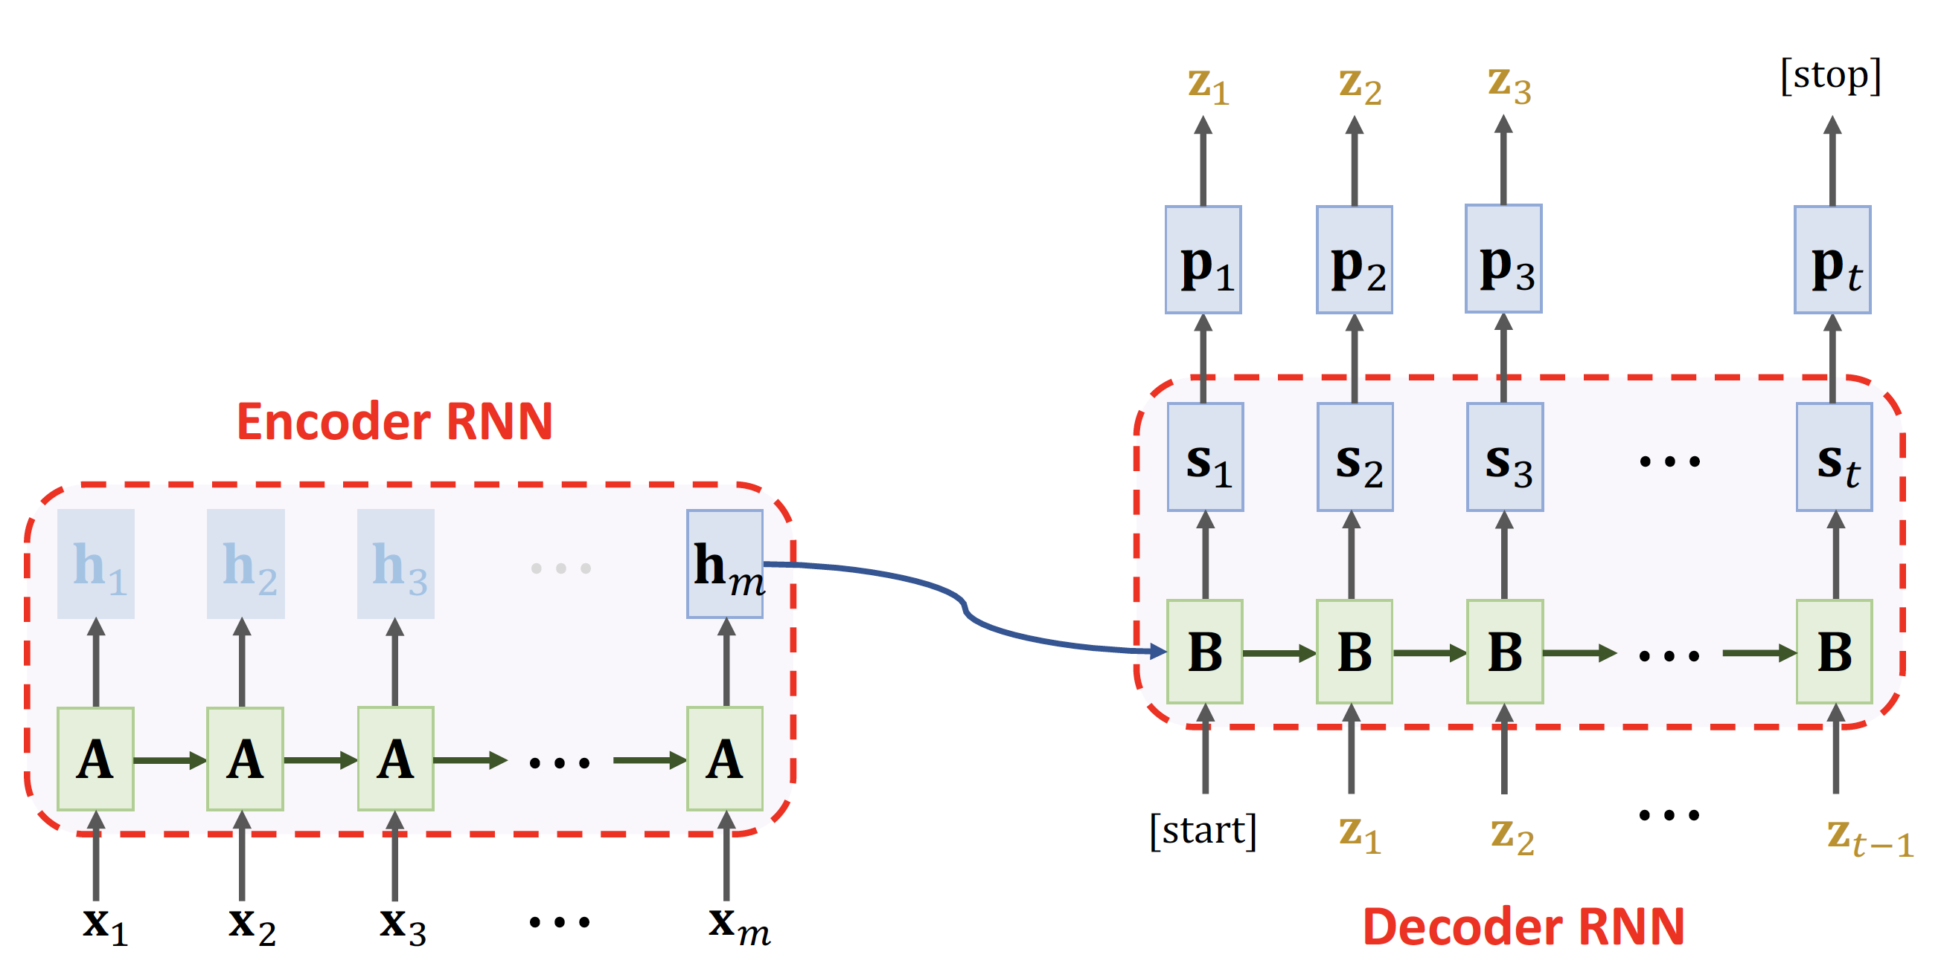
Seq2Seq Model

Slide 42
An example
hidden states
(discarded)
LSTM Encoder
states (ℎ₀)
"go away"

Slide 43
An example
LSTM Decoder
states (ℎ₀)
"\t"
The [start] sign

Slide 44
An example
states (ℎ₁)
"m"
LSTM Decoder
states (ℎ₀)
"\t"
The [start] sign
Record: "m"

Slide 45
An example
states (ℎ₁)
LSTM Decoder
"m"
Record: "m"

Slide 46
An example
states (ℎ₂)
"a"
states (ℎ₁)
LSTM Decoder
"m"
Record: "ma"

Slide 47
An example
states (ℎ₂)
LSTM Decoder
"a"
Record: "ma"

Slide 48
An example
states (ℎ₃)
"c"
states (ℎ₂)
LSTM Decoder
"a"
Record: "mac"

Slide 49
An example
states (ℎ*,𝑐*) "c"
states (ℎ₎,𝑐₎) LSTM Decoder
"a"
Record: "mac"
Repeat this process

Slide 50
An example
states (ℎ₁₄)
LSTM Decoder
"e"
Record: "mach ne fliege"

Slide 51
An example
The [stop] sign
states (ℎ₁₅)
"\n"
states (ℎ₁₄)
LSTM Decoder
"e"
Record: "mach ne fliege"

Slide 52
An example
The [stop] sign
states (ℎ₁₅)
"\n"
states (ℎ₁₄)
LSTM Decoder
"e"
Return: "mach ne fliege"

Slide 53
How to Improve?

Slide 54
Bi-LSTM instead of LSTM (Encoder only!)
Encoder’s final states have all the information of the English sentence.
If the sentence is long, the final states have forgotten early inputs.

Slide 55
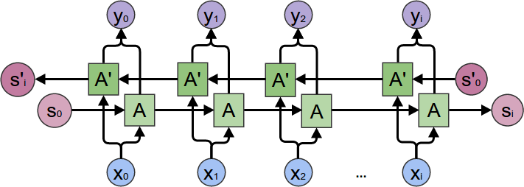
Bi-LSTM instead of LSTM (Encoder only!)
Encoder’s final states have all the information of the English sentence.
If the sentence is long, the final states have forgotten early inputs.
Bi-LSTM (left-to-right and right-to-left) has longer memory.
⋯
⋯

Slide 56
Bi-LSTM instead of LSTM (Encoder only!)
Encoder’s final states have all the information of the English sentence.
If the sentence is long, the final states have forgotten early inputs.
Bi-LSTM (left-to-right and right-to-left) has longer memory.
Use Bi-LSTM in the encoder; use unidirectional LSTM in the decoder.

Slide 57
How to Improve?
Bi-LSTM instead of LSTM. (Encoder only!)
Attention

Slide 58
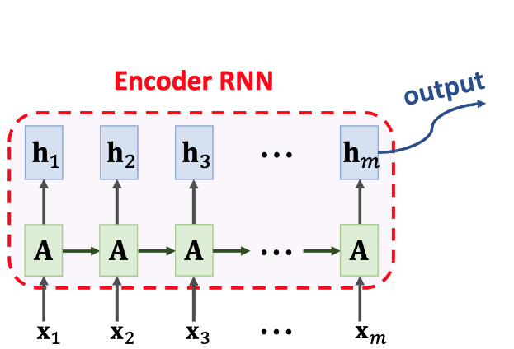
Seq2Seq Model

Slide 59
Seq2Seq Model

Slide 60
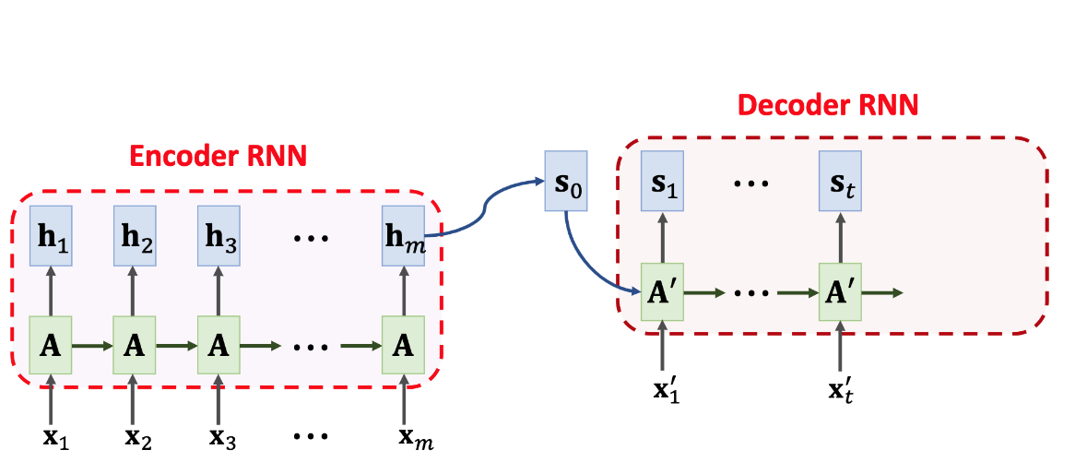
Seq2Seq Model

Slide 61
Seq2Seq Model
Shortcoming: The final state is incapable of remembering a long sequence.

Slide 62
Seq2Seq Model
Shortcoming: The final state is incapable of remembering a long sequence.
BLEU
Seq2Seq without attention
sequence length (# words)
20 words
50 words

Slide 63
Seq2Seq Model
Shortcoming: The final state is incapable of remembering a long sequence.
Seq2Seq with attention
BLEU
Seq2Seq without attention
sequence length (# words)
20 words
50 words

Slide 64
Attention for Seq2Seq Model

Slide 65
Seq2Seq Model with Attention
Attention tremendously improves Seq2Seq model.
With attention, Seq2Seq model does not forget source input.
With attention, the decoder knows where to focus.
Downside: much more computation.
Original paper:
Bahdanau, Cho, & Bengio. Neural machine translation by jointly learning to align and translate. In ICLR, 2015.

Slide 66
SimpleRNN + Attention
Root problem: S0 is assigned with hm ONLY

Slide 67
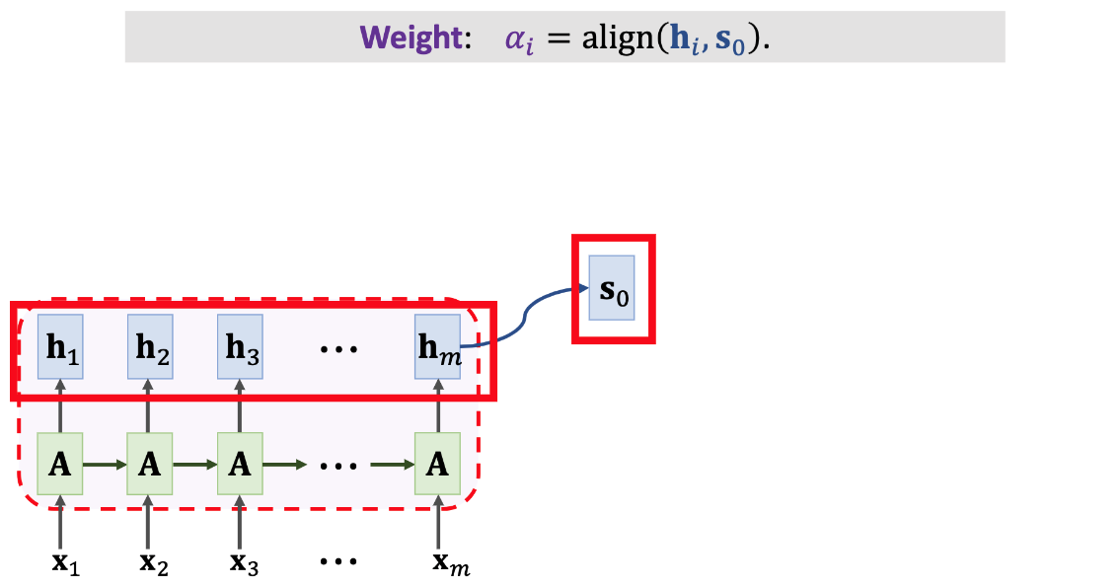
SimpleRNN + Attention
Key idea:
S0 should be explicitly dependent on all the hi

Slide 68
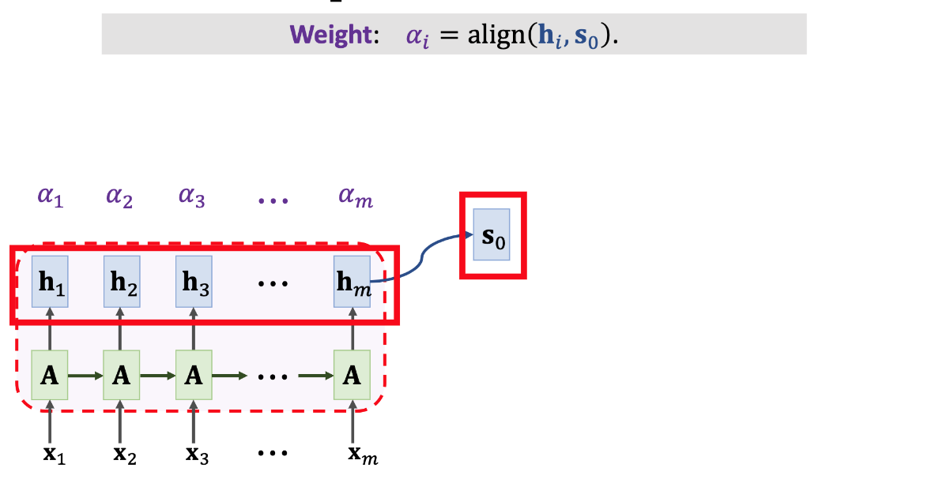
SimpleRNN + Attention
Key idea:
S0 should be explicitly dependent on all the hi

Slide 69
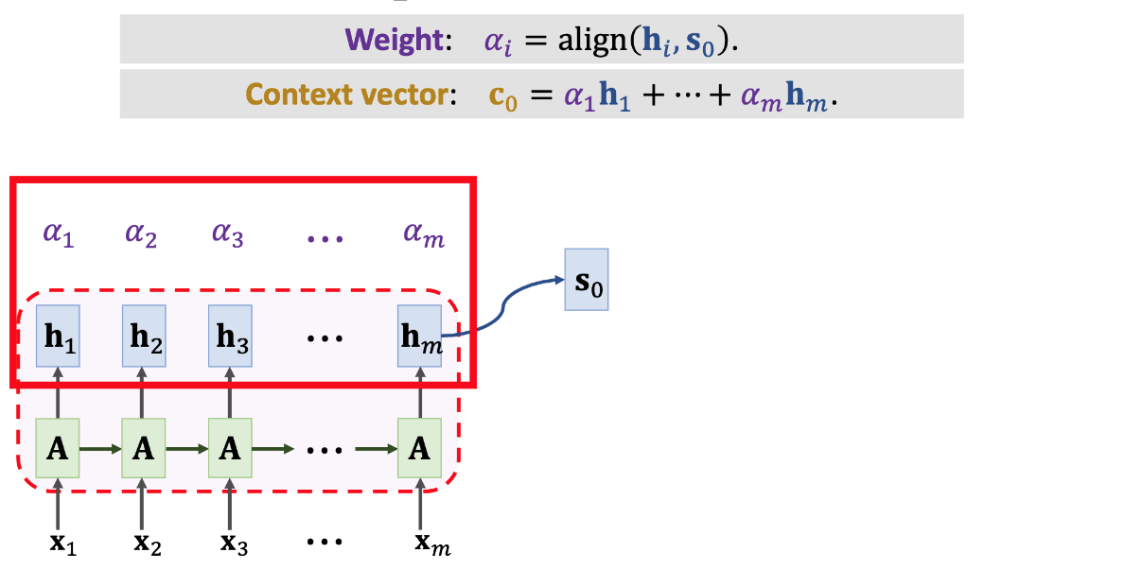
SimpleRNN + Attention

Slide 70
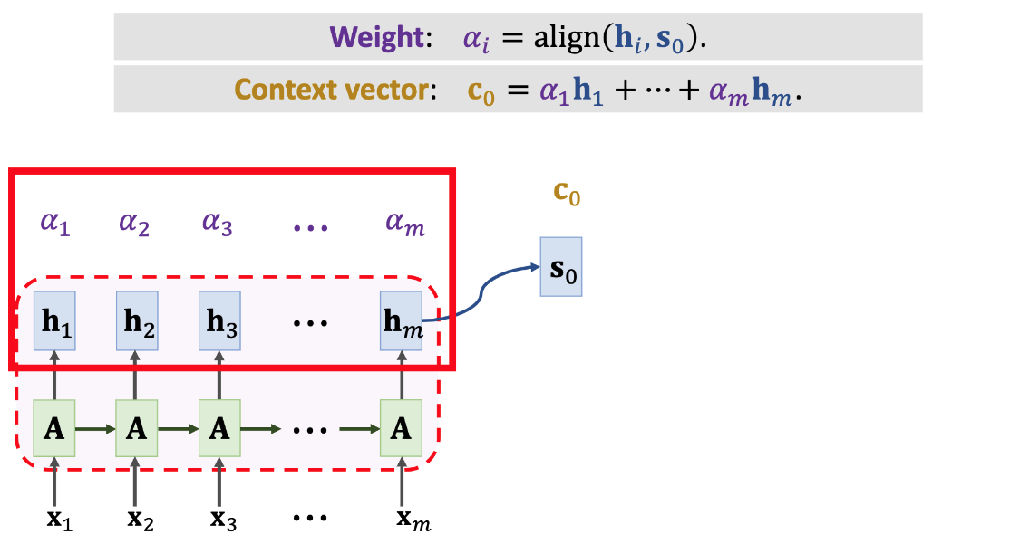
SimpleRNN + Attention

Slide 71
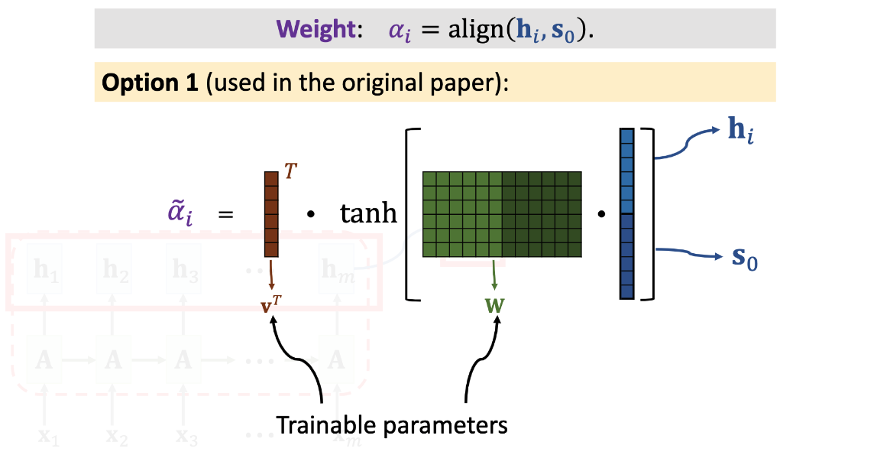
SimpleRNN + Attention

Slide 72
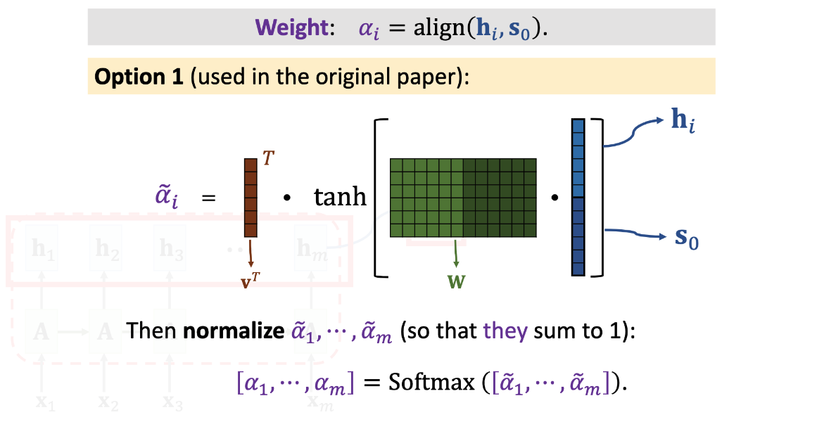
SimpleRNN + Attention

Slide 73
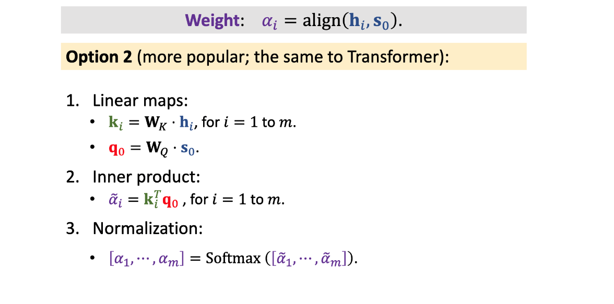
SimpleRNN + Attention
Why do we need WK and WQ?

Slide 74
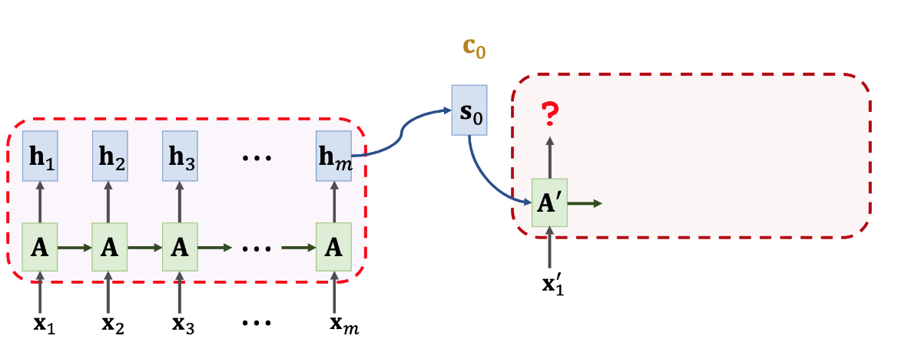
SimpleRNN + Attention

Slide 75
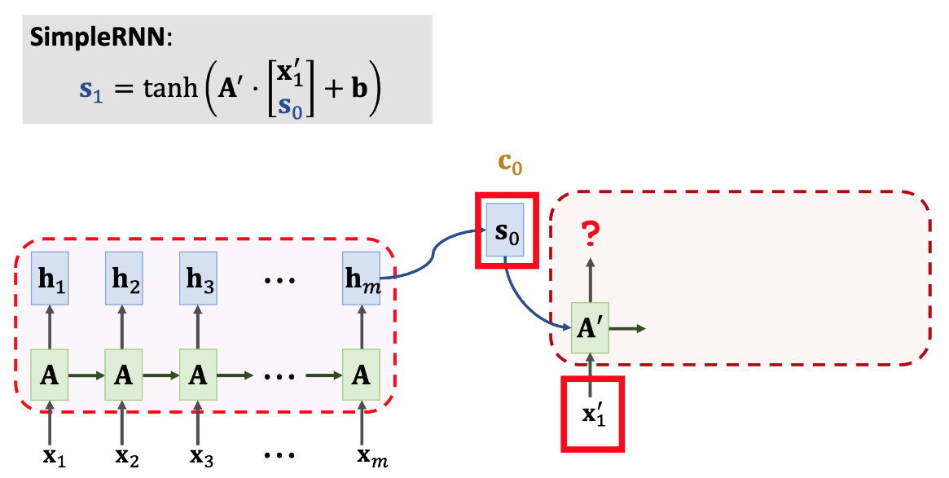
SimpleRNN + Attention

Slide 76
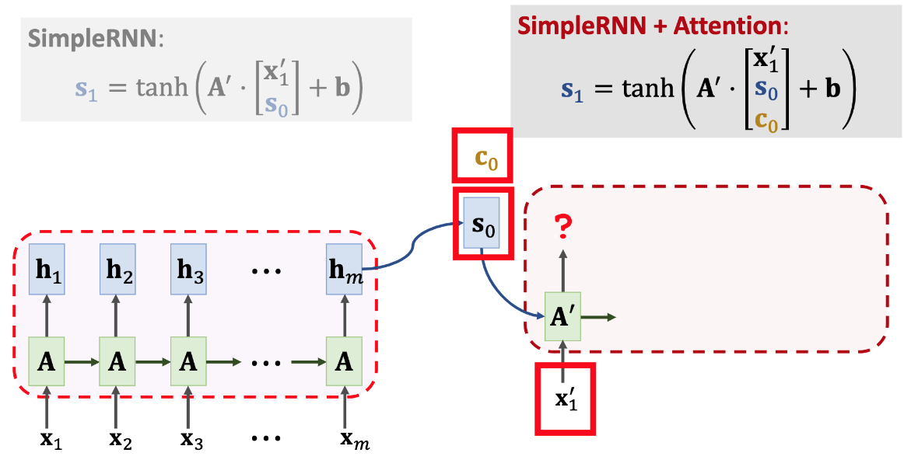
SimpleRNN + Attention
Should we incorporate S0 here?

Slide 77
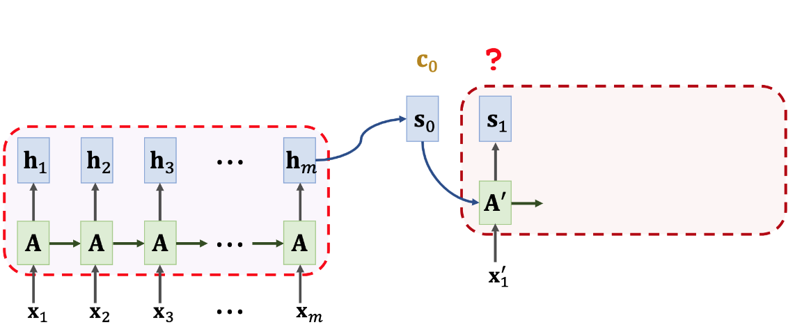
SimpleRNN + Attention

Slide 78
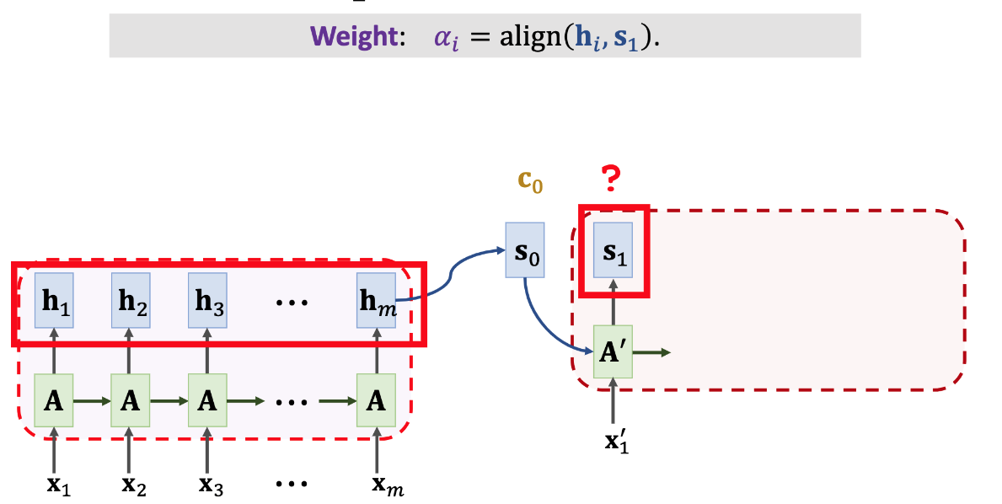
SimpleRNN + Attention

Slide 79
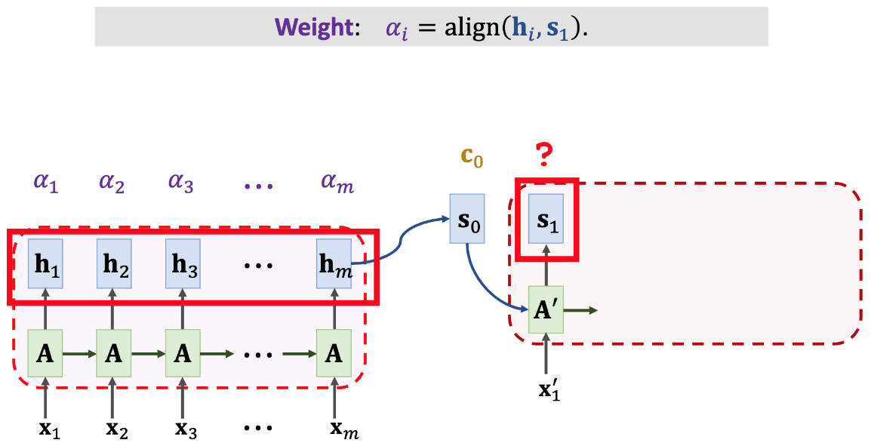
SimpleRNN + Attention

Slide 80
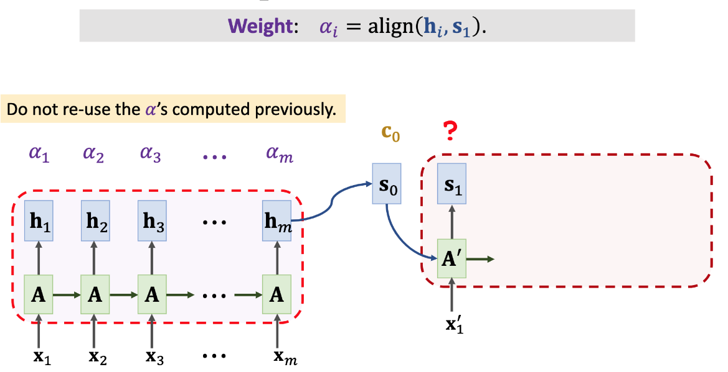
SimpleRNN + Attention

Slide 81
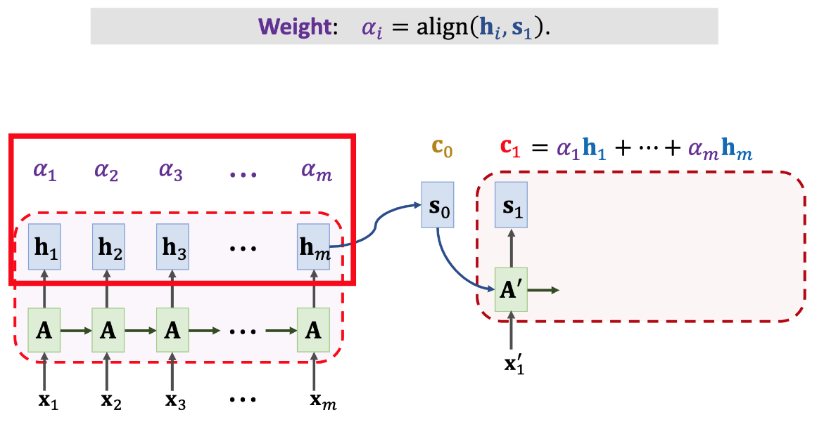
SimpleRNN + Attention

Slide 82
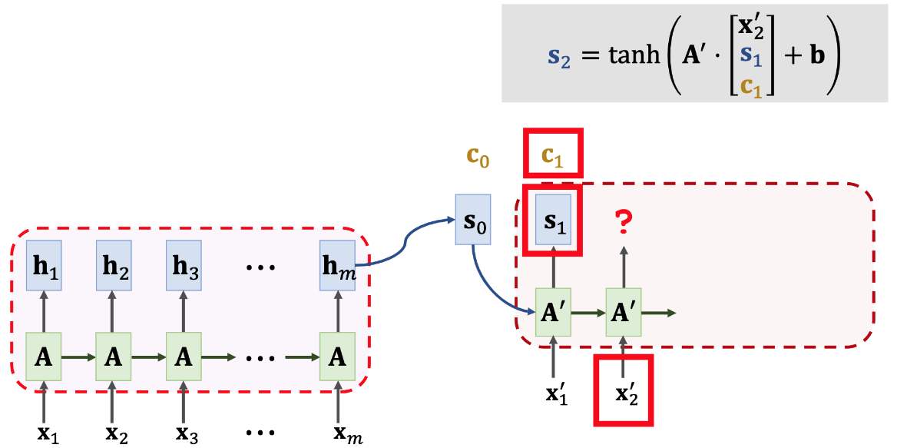
SimpleRNN + Attention

Slide 83
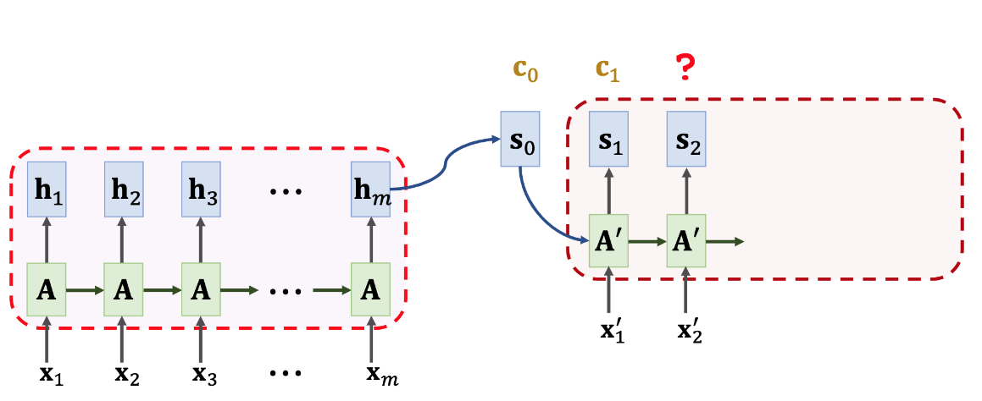
SimpleRNN + Attention

Slide 84
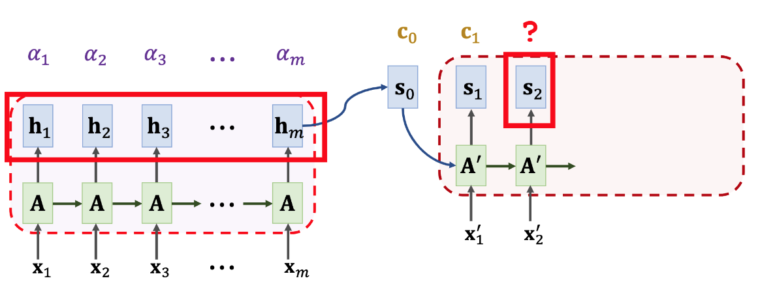
SimpleRNN + Attention

Slide 85
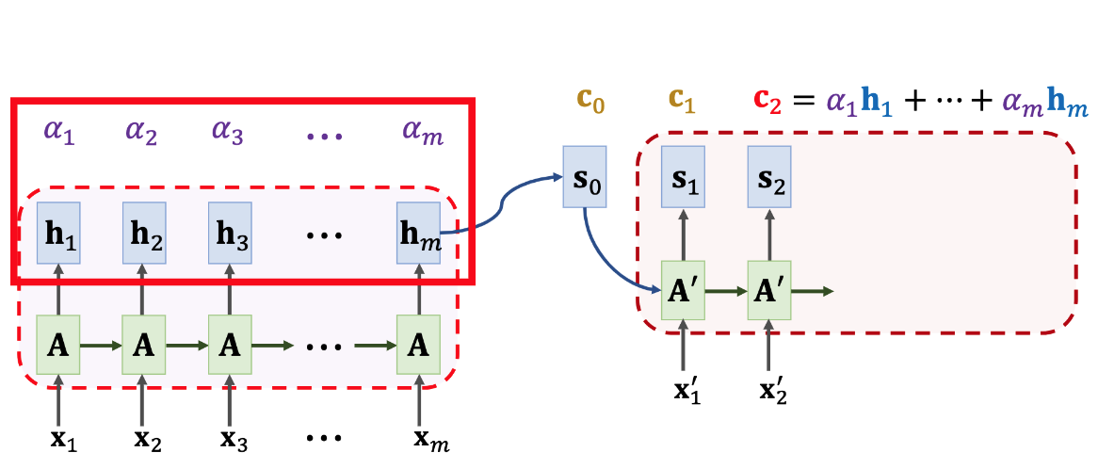
SimpleRNN + Attention

Slide 86
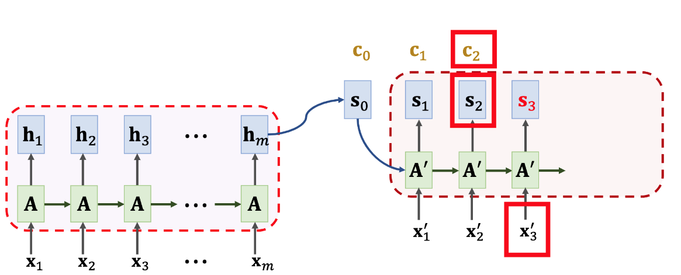
SimpleRNN + Attention

Slide 87

SimpleRNN + Attention

Slide 88

SimpleRNN + Attention

Slide 89

SimpleRNN + Attention

Slide 90

SimpleRNN + Attention

Slide 91

SimpleRNN + Attention

Slide 92

SimpleRNN + Attention

Slide 93

Time Complexity
Question: How many weights 𝛼₁ have been computed?

Slide 94
Time Complexity
Question: How many weights 𝛼₁ have been computed?
To compute one vector 𝐜cj we compute 𝑚 weights: 𝛼₁ , ⋯ , 𝛼_{m}.
The decoder has 𝑡 states, so there are totally mt weights.

Slide 95

Attention: Weights Visualization
Decoder RNN (target language: French)
Encoder RNN (source language: English)
Figure is from https://distill.pub/2016/augmented-rnns/

Slide 96
Attention: Weights Visualization
Decoder RNN (target language: French)
Encoder RNN (source language: English)
Figure is from https://distill.pub/2016/augmented-rnns/

Slide 97
Summary
Standard Seq2Seq model: the decoder looks at only its current state.

Slide 98
Summary
Standard Seq2Seq model: the decoder looks at only its current state.
Attention: decoder additionally looks at all the states of the encoder.

Slide 99
Summary
Standard Seq2Seq model: the decoder looks at only its current state.
Attention: decoder additionally looks at all the states of the encoder.
Attention: decoder knows where to focus.

Slide 100

Summary
Standard Seq2Seq model: the decoder looks at only its current state.
Attention: decoder additionally looks at all the states of the encoder.
Attention: decoder knows where to focus.

Slide 101
Self-Attention

Slide 102
Self-Attention
Attention [1] is designed for Seq2Seq which includes 2 RNNs: RNN Encoder + RNN Decoder.
Self-Attention [2]: improvement over a single RNN.
Key idea: calculate state vector using context vector.
Original paper:
Bahdanau, Cho, & Bengio. Neural machine translation by jointly learning to align and translate. In ICLR, 2015.
Cheng, Dong, & Lapata. Long Short-Term Memory-Networks for Machine Reading. In
EMNLP, 2016.

Slide 103

SimpleRNN

Slide 104

SimpleRNN + Self-Attention

Slide 105

SimpleRNN + Self-Attention

Slide 106

SimpleRNN + Self-Attention

Slide 107

SimpleRNN + Self-Attention

Slide 108

SimpleRNN + Self-Attention

Slide 109

SimpleRNN + Self-Attention

Slide 110

SimpleRNN + Self-Attention

Slide 111

SimpleRNN + Self-Attention

Slide 112

SimpleRNN + Self-Attention

Slide 113

SimpleRNN + Self-Attention

Slide 114

SimpleRNN + Self-Attention

Slide 115

SimpleRNN + Self-Attention

Slide 116

SimpleRNN + Self-Attention

Slide 117

SimpleRNN + Self-Attention

Slide 118

SimpleRNN + Self-Attention

Slide 119

SimpleRNN + Self-Attention

Slide 120

SimpleRNN + Self-Attention

Slide 121

SimpleRNN + Self-Attention

Slide 122

SimpleRNN + Self-Attention

Slide 123

SimpleRNN + Self-Attention

Slide 124

SimpleRNN + Self-Attention

Slide 125

SimpleRNN + Self-Attention

Slide 126

SimpleRNN + Self-Attention

Slide 127

SimpleRNN + Self-Attention

Slide 128

SimpleRNN + Self-Attention

Slide 129

SimpleRNN + Self-Attention

Slide 130

SimpleRNN + Self-Attention

Slide 131

SimpleRNN + Self-Attention

Slide 132

SimpleRNN + Self-Attention

Slide 133
Summary
With self-attention, RNN is less likely to forget.

Slide 134

Summary
With self-attention, RNN is less likely to forget.
Pay attention to the context relevant to the new input.

Slide 135
Any Question ?

